Slide 1
File Search Engine
Guided By By
SRI B. Ramdasu R . Lalith
1601-12-733-102

Slide 2
Abstract
File Search Engine
Requirements
Software : Eclipse
Programming Language : Java

Slide 3
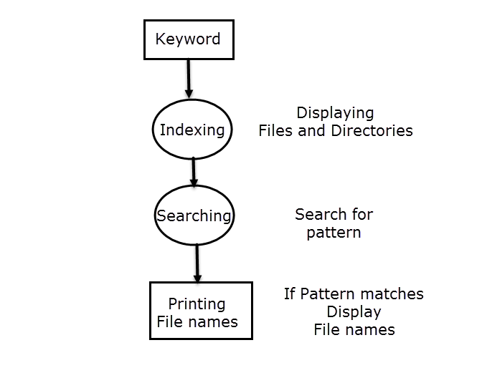

Slide 4
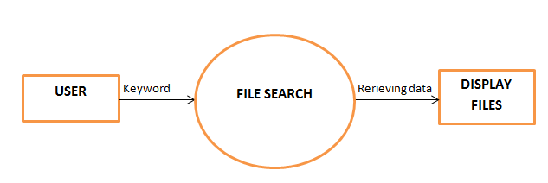
DFD LEVEL - 0

Slide 5
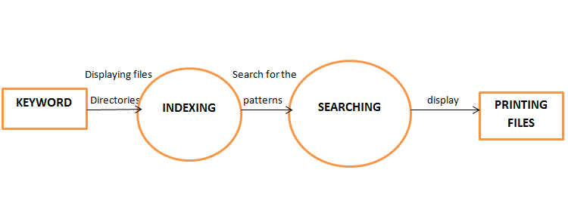
DFD LEVEL - 1

Slide 6
Objectives
Search Files in any Specified Directory
Boolean Operations can be implemented in input string
Contents of the matched file can be viewed

Slide 7
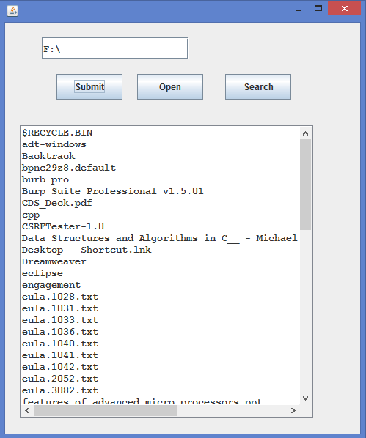
Display Files and Directories

Slide 8
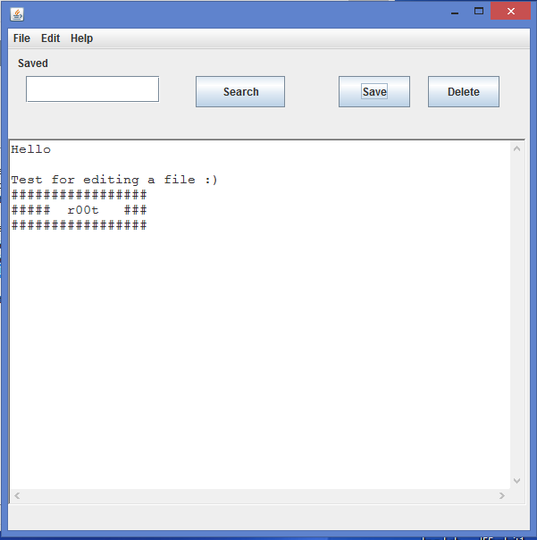
Save contents of file

Slide 9
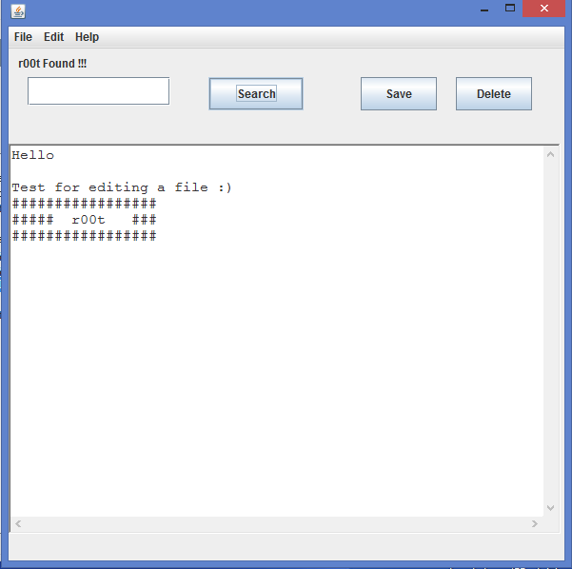
Search content in a File

Slide 10
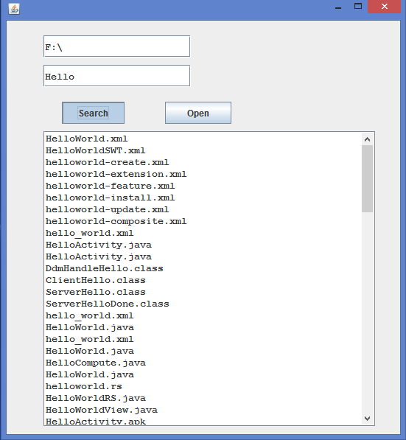
Searching a file

Slide 11
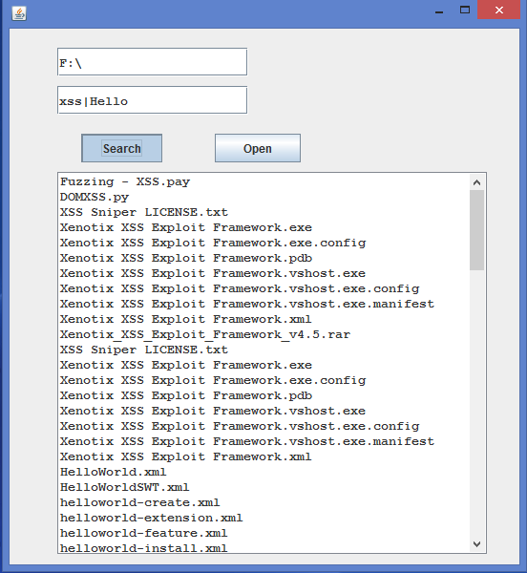
Boolean operations in Search

Slide 12
Extension
File search can be extended to file browser
In a LAN environment File search can be implemented on remote machines with the help of private IP address .
File search is mainly implemented in File Transfer Protocol .

Slide 13
Thank you ☺

